Slide 1
JOHN ADAMS AS PRESIDENT
ADAMS
THE SECOND PRESIDENT
XYZ AFFAIR
ALIEN &
SEDITION ACTS
THE KENTUCKY
AND VIRGINIA
RESOLUTIONS

Slide 2
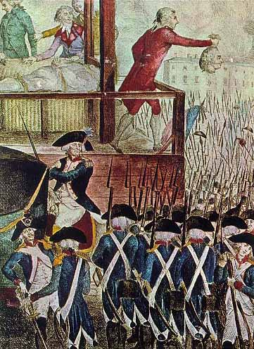
XYZ AFFAIR
France became upset with the U.S. because
a) we didn’t help them in the French Revolution
b) we signed a treaty with Great Britain encouraging trade
France began attacking U.S. ships involved in trade with Great Britain

Slide 3
Adams sent John Marshall, Elbridge Gerry, & Charles Pinckney on a peace mission to France
French foreign minister Talleyrand refused to see them himself
He sent three men whose identities were kept secret
They were known only as “X, Y, and Z”

Slide 4
X, Y, and Z proposed that the U.S. pay $250,000 to see Talleyrand
This brought about the saying “Millions for defense; not one cent for tribute!”
http://www.youtube.com/watch?v=afB5NJmER5M&feature=related&safety_mode=true&persist_safety_mode=1

Slide 5
THE ALIEN AND SEDITION ACTS
Our government began to worry about subversion
Subversion—activity designed to overthrow a government
In response, Adams passed four laws

Slide 6
Sedition Act—allowed for punishment of those who criticized the government verbally or in writing
Naturalization Act—made it more difficult for foreigners to become US citizens saying they had to live in the U.S. for 14 years instead of 5
Alien Act & Alien Enemies Act—gave the president power to imprison or deport aliens suspected of activities posing a threat to the national government
Many felt these laws were unfair and were designed to keep Federalists strong and Republicans weak

Slide 7
THE KENTUCKY AND VIRGINIA RESOLUTIONS
Proposed in response to Adams’ four acts
They wanted to increase the power of the states
They wanted to limit the power of the national government

Slide 8
KENTUCKY RESOLUTION
Said the national government had no right to exercise powers not specifically given in the Constitution
Proposed by Thomas Jefferson

Slide 9
Virginia
Resolution
Said states should be able to nullify (cancel) federal laws they oppose
Neither resolution passed, but it addressed states’ rights for the first time

