Slide 1
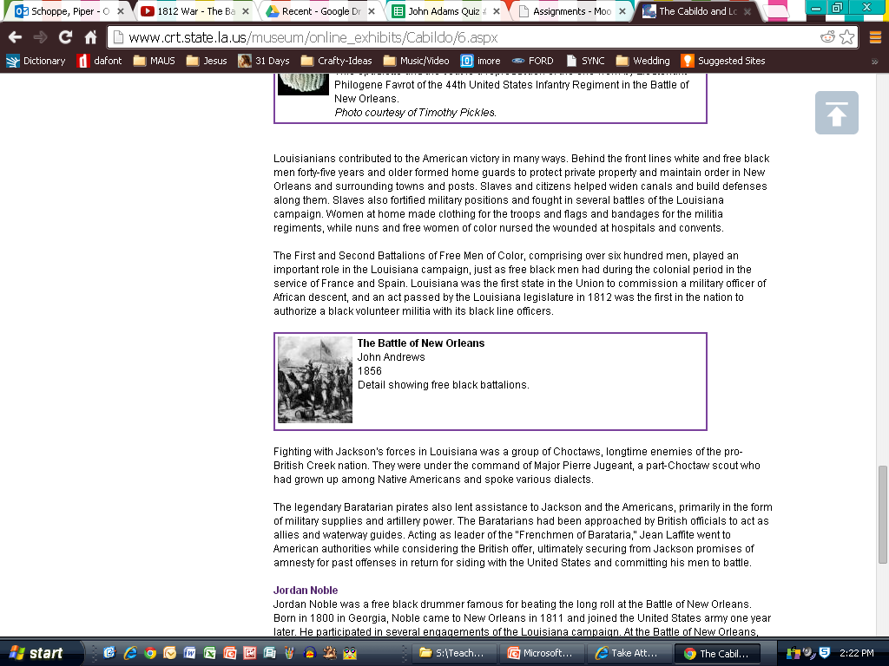
http://www.crt.state.la.us/museum/online_exhibits/Cabildo/6.aspx

