Slide 1
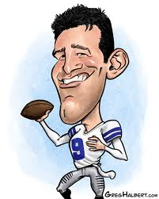
Your Historical Caricature must:
Caricature must be one of the European groups in the Americas that we studied: Spanish, French or Dutch.
Have 6 “accessories” symbolizing information you learned during our research.
Each accessory has to be labeled and explained on the back or bottom
Your Caricature must be neat, creative and colorful!
WOW me!!!! First Major Grade!

