Slide 1
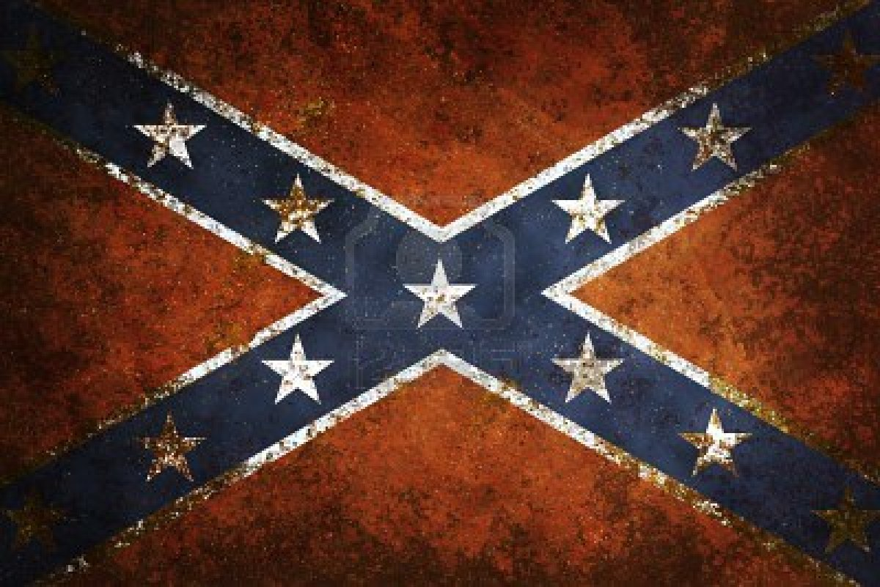
People of the US Civil War
Complete the following on a sheet of notebook paper.
For each person, write a description and then create a Newspaper headline to describe their role in the civil war.
Example:
“George Washington Leads American Soldiers to victory at Yorktown!”

Slide 2
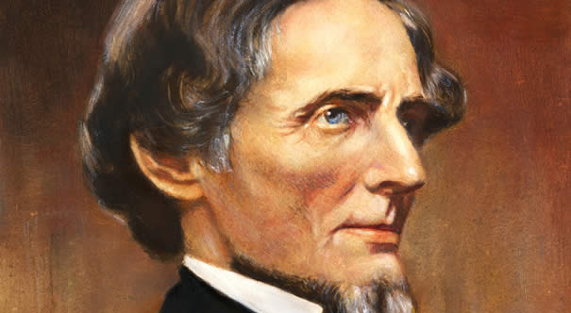
Jefferson Davis
President of the Confederate States of America

Slide 3
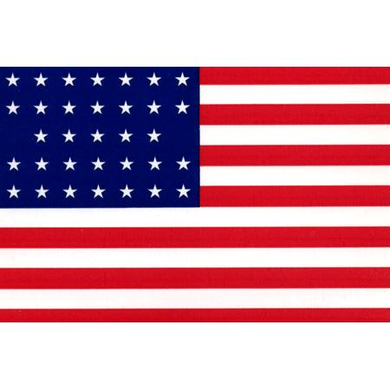
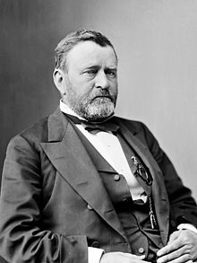
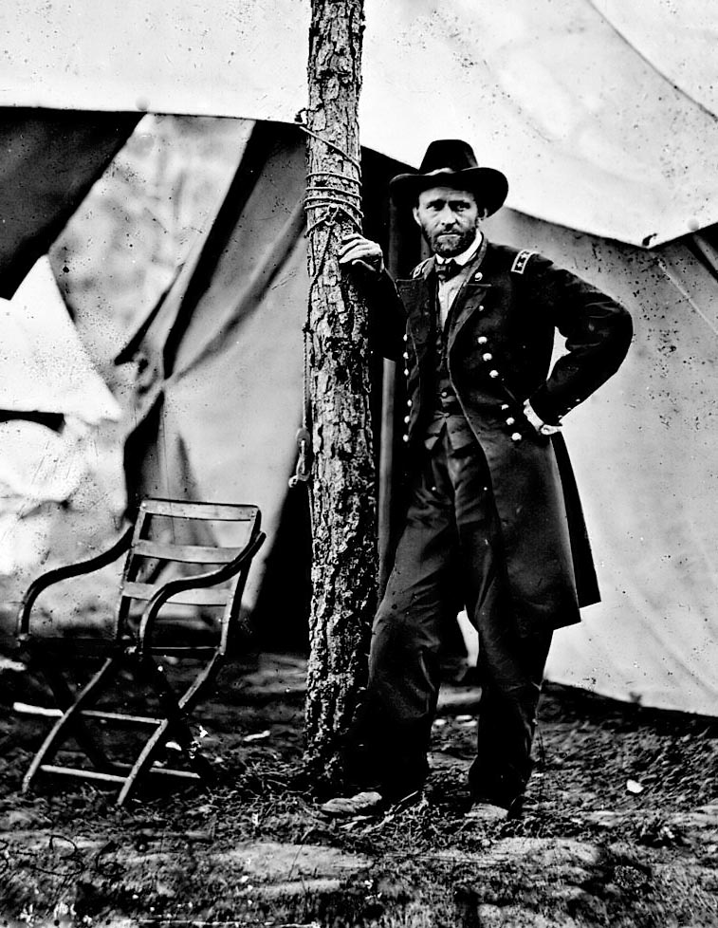
Ulysses S. Grant
I know only two tunes: one of them is, “Yankee Doodle,” and the other isn’t.
General of the Union Army
His goal was the total destruction of Confederate forces.
He waged war on the economic resources that were supporting the Confederate army.
Notes:
Sonofthesouth.com
Grant led his Union soldiers to victory at the Battle of Vicksburg.
Lincoln was so impressed with Grant’s leadership that he put him in charge of all Union forces.

Slide 4
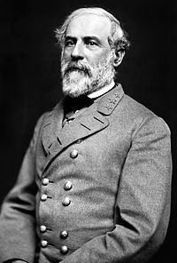
Robert E. Lee
General of the Confederate Army.
West Point graduate
Legendary military commander (U.S.-Mexican War)
Lincoln asked Lee to lead Northern troops but Lee felt he had to fight on the side of his home state (Virginia).

Slide 5
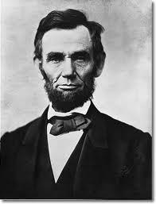
Abraham Lincoln
President of the Union during the Civil War.
Began the process (Emancipation Proclamation) that led to the end of slavery in the U.S.
Lincoln’s also remembered for his leadership, integrity, speeches and letters.
Lincoln’s Main Goal: reuniting the nation like it was before the war started.
Secondary Goal: freeing the slaves.
Notes:
http://rogerjnorton.com/Lincoln87.html

Slide 6
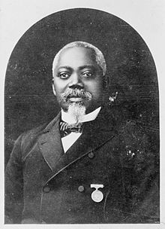
William Carney
Received his medal for saving the American flag and planting it on the parapet and although wounded, holding it while the troops charged
Part of the Union’s assault on Fort Wagner.
First African American to be awarded the Congressional Medal of Honor.

Slide 7
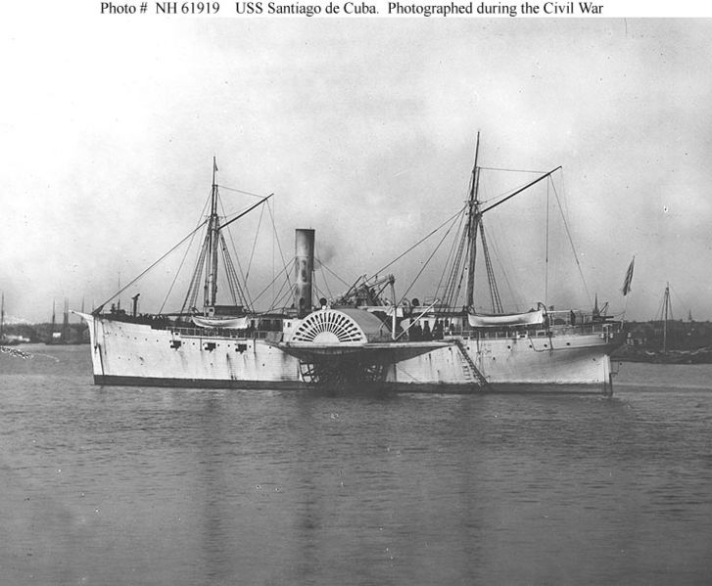
Philip Bazaar
Resident of Massachusetts
Chilean immigrant
Joined the Union Navy
Assigned to the USS Santiago de Cuba during the Civil War
He was awarded the Medal of Honor for carrying dispatches (messages) during battle while under heavy fire Confederate gunfire.
Bazaar became the first Hispanic-American to be awarded the Congressional Medal of Honor.

Slide 8
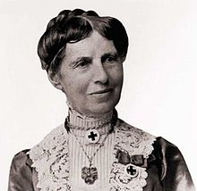
Clara Barton
Risked her life to bring supplies and support to the soldiers in the field during the Civil War.
Founded the Red Cross in 1881.
Notes:
http://www.redcross.org/museum/history/claraBarton.asp

