Slide 1
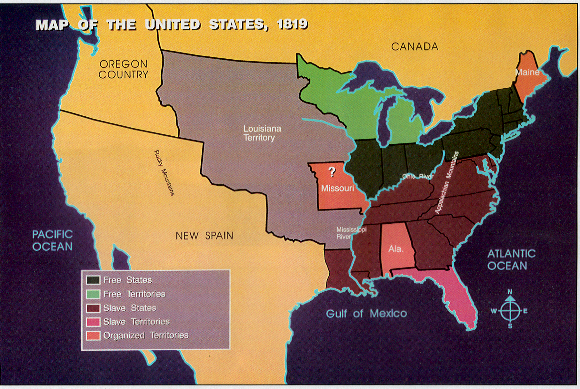
South’s Position:
statehood for Missouri as
a slave state
2) Slaveholders have the
right to settle any new terr.
3) Oppose any solution that
makes more free states than
slave states
North’s Position:
statehood for Missouri &
Maine as free state
2) Do not want slavery to
expand in Louisiana Territory
3) Oppose any solution that
makes more slave states
than free states
The year is 1820. The debate over statehood for Missouri is
getting hotter day by day. To complicate matters, Maine has just
applied for admission to the union as well. Your job is to find a
way to settle this controversy that is acceptable to both the North
and the South.

Slide 2
Address these questions:
Should Missouri be admitted to the union as a slave state, free state,
or not at all?
2) What stand, if any, should Congress take on the spread of slavery
across the Louisiana territory?
3) What should Congress do about Maine’s request for statehood?

Slide 3
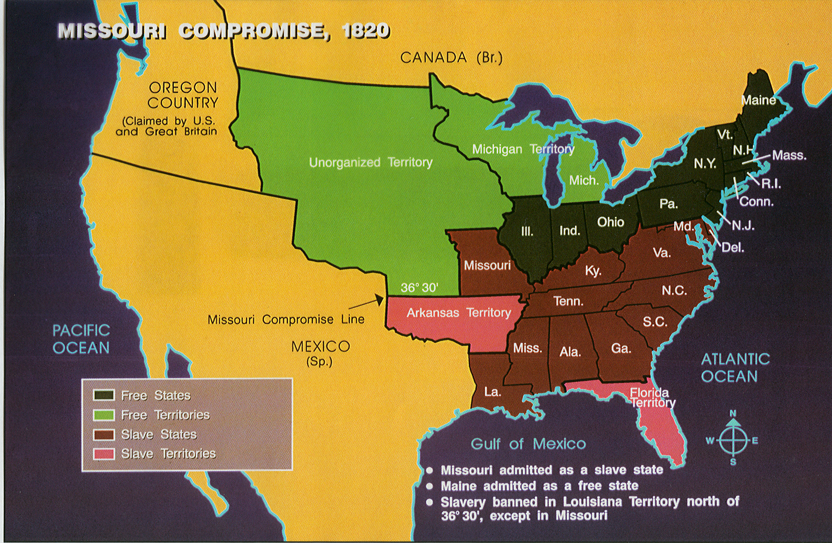
What really happened:
Missouri was admitted as a slave state
2) Maine was admitted as a free state
3) Slavery would be banned north of the 36 30 line of latitude except in
Missouri

Slide 4
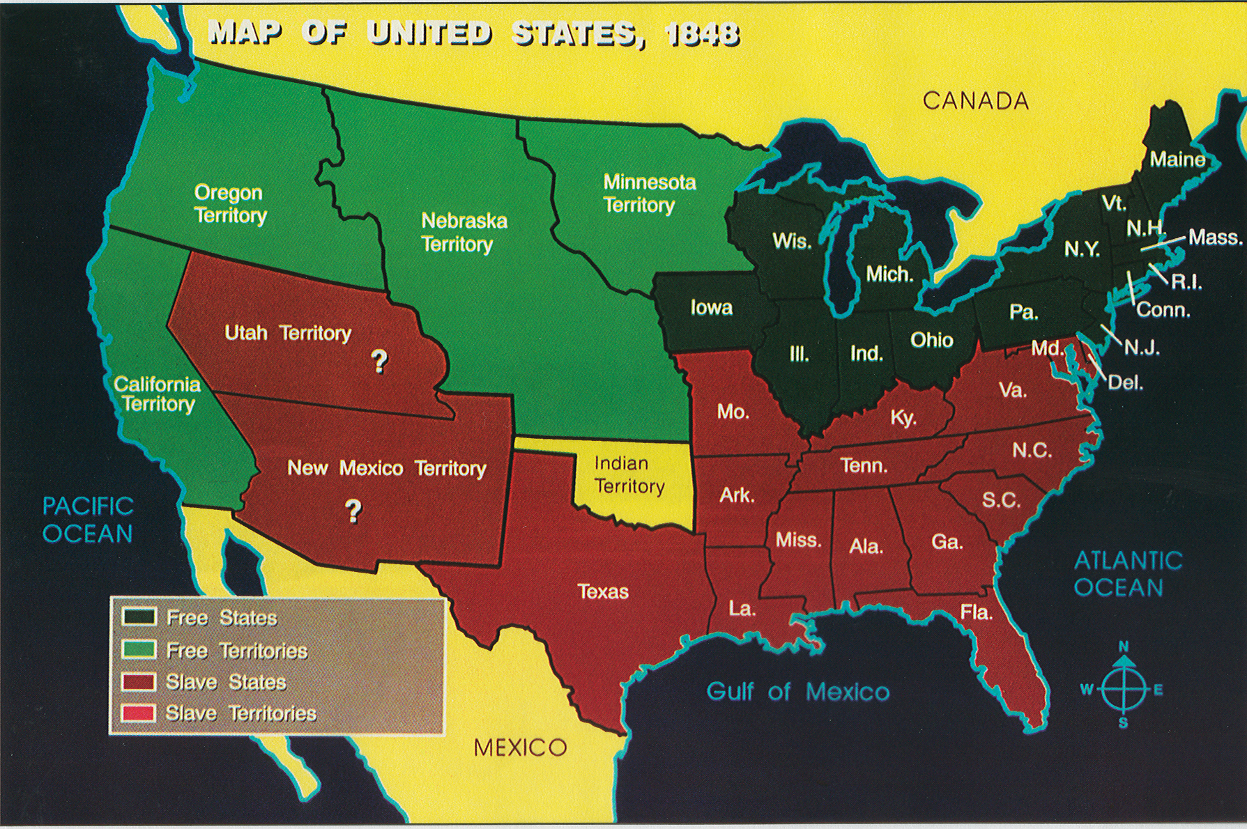
The year is 1850. The state count stands at 15 free and 15 slave
states. California has applied for statehood. The United States has
just recently added the Mexican Cession after the Mexican War.
your job is to find a way to settle this controversy that is acceptable
to both the North and the South.

Slide 5
South’s Position:
Reluctant to add Calif.
unless other territories are
open to slavery
2) Slavery must be allowed in
Utah & New Mexico territories
3) Continue to allow slavery
Where it already exists
4) Strong fugitive slave law to
Help track down runaways
North’s Position:
statehood for California as
free state
2) Ban slavery in New Mexico
and Utah Territories
3) End to slavery in D.C.
4) Oppose any fugitive slave
law that would endanger
runaways

Slide 6
Address these questions:
1) Should California be admitted to the union as a free or slave state?
2) What stand, if any, should Congress take on the future of slavery in New
Mexico and Utah territories?
3) What, if anything, should be done about slavery in Washington D.C.?
4) Should Congress pass a strong new fugitive slave law?

Slide 7
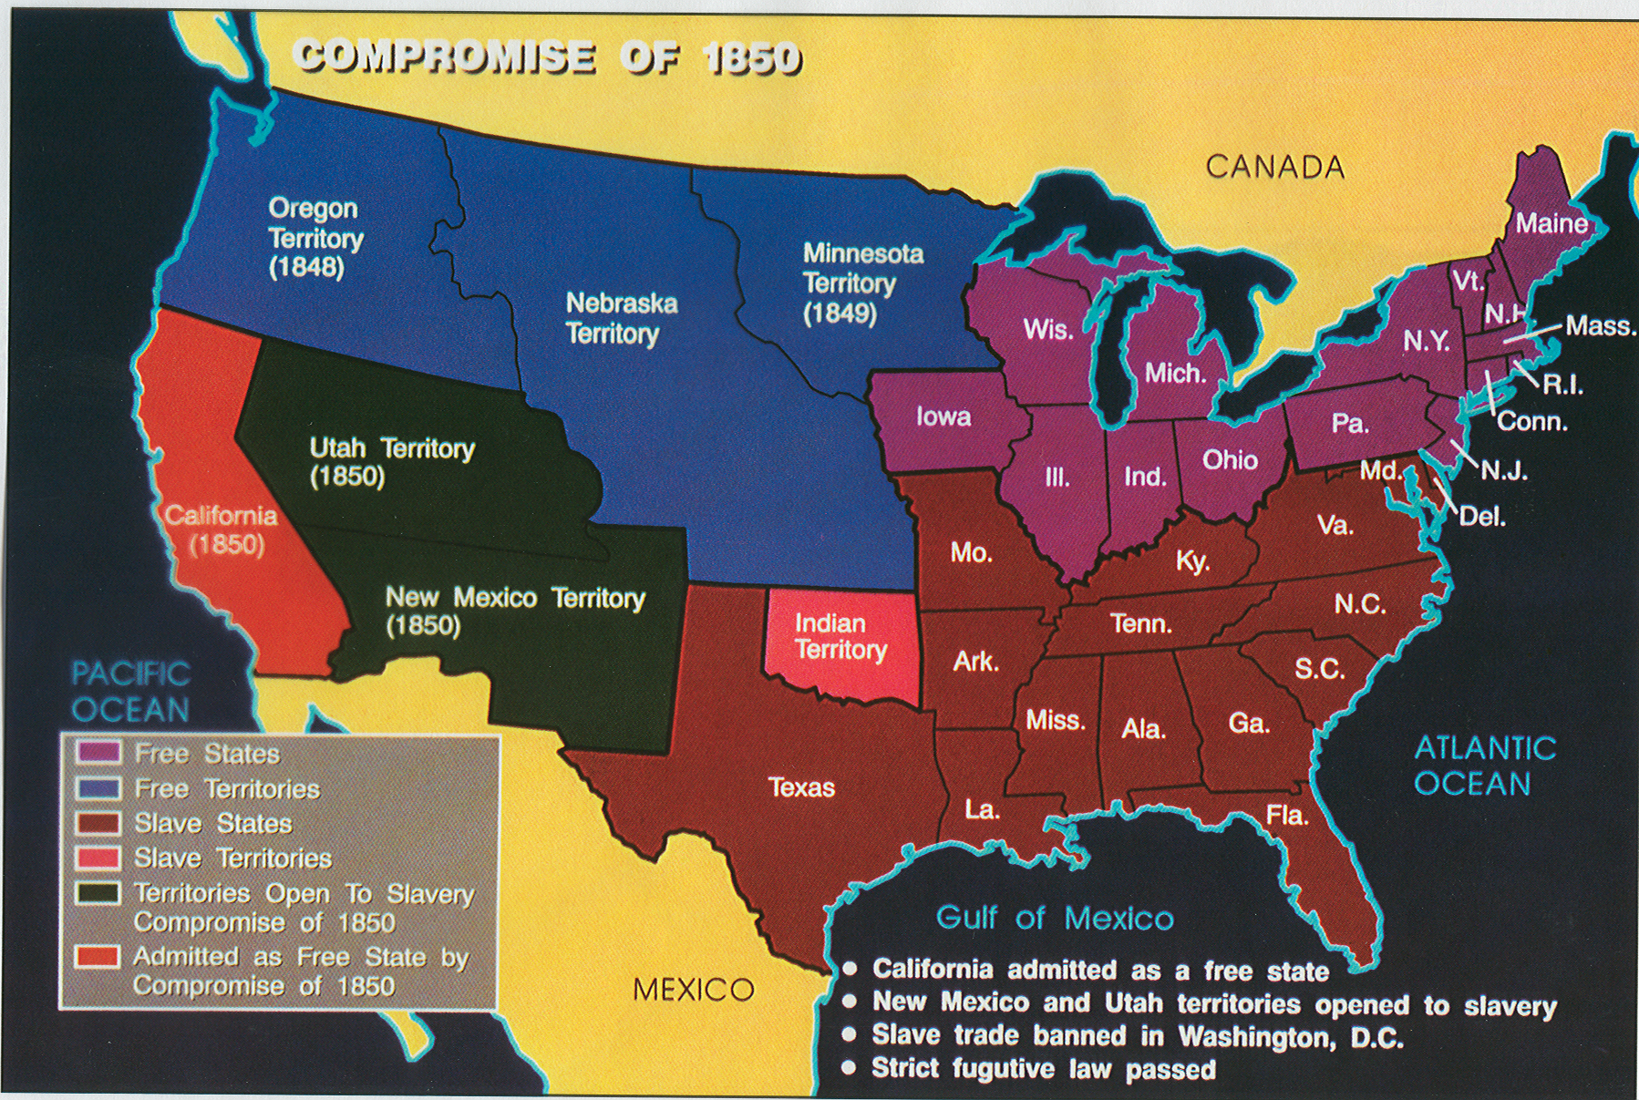
What really happened:
California admitted as a free state
2) New Mexico & Utah territories opened to slavery
3) Slave trade banned in Washington D.C.
4) Strict fugitive slave law passed

Slide 8
Attention!!!
Page 6 has the Election of 1860 twice. The top part (part IV) should be Dred Scott vs Sanford.

Slide 9
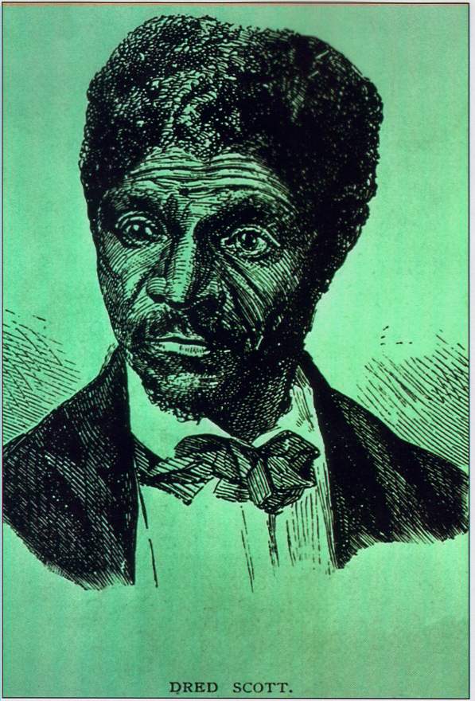
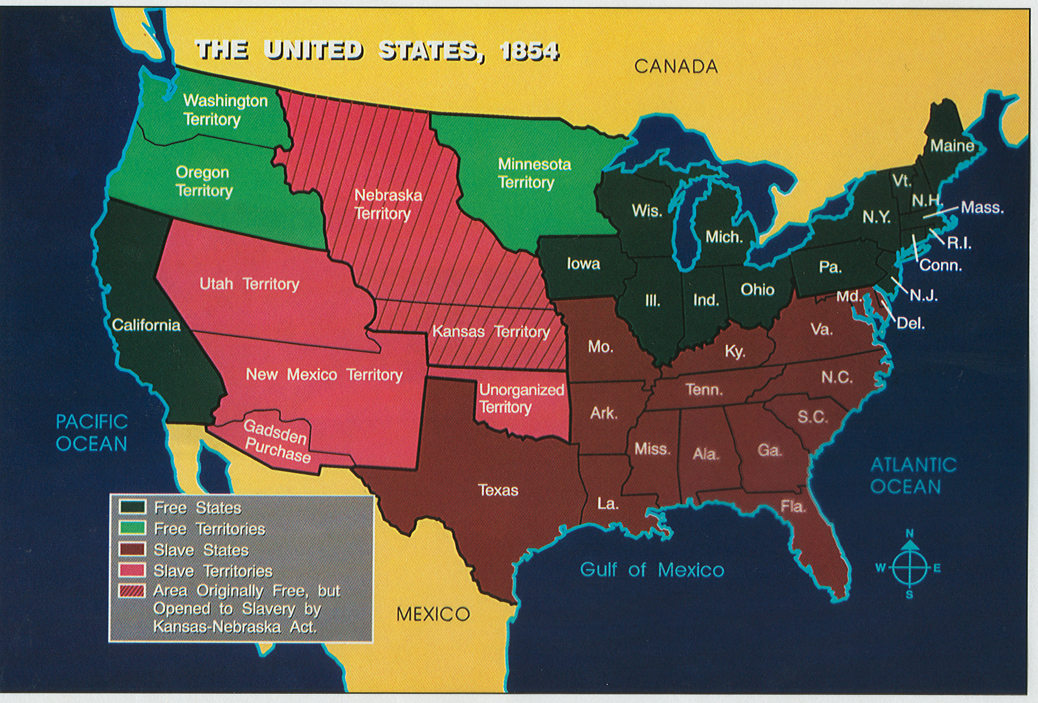
Dred Scott vs Sanford
Write this on your notes pages!!!!
The year is 1857. The Supreme Court is considering the case of
Dred Scott, a slave who is suing for his freedom. Scott had
traveled with his owner to Wisconsin Territory. Now Scott was
arguing that because the Missouri Compromise banned slavery in
Wisconsin, his time in that free territory had made him a free man.

Slide 10
South’s Position:
Scott was born a slave, not
a citizen, and has no right to sue
2) Scott returned to Missouri
with his owner as a slave and
should continue to be treated
as a slave
3) Under the Constitution,
Congress cannot make laws
that deny people the use of
their property (including slaves)
anywhere, including territories.
North’s Position:
Constitution does not limit
Citizenship to white people.
Blacks have legal rights.
2) By taking Scott to free
territory, his owner gave up
his right to treat Scott as a
slave
3) Congress can make laws
banning slavery in territories

Slide 11
Address these questions:
1) Is Dred Scott a citizen with the right to sue in a federal court?
2) Did Scott’s visit to a free territory make him a free man?
3) Should Congress be able to ban slavery in the territories?

Slide 13
The year is 1860. Lincoln has just been elected president. The
slave states are talking about secession (leaving the union).
Your job is to find some compromise on slavery that will prevent
the Civil War.

Slide 14
North’s Position:
Slavery is immoral and
should not be allowed to
expand
2) Secession is illegal.
3) The Union must be
preserved; we will fight to
keep it together.
South’s Position:
Slavery is moral and
should be allowed to expand
2) A state enters the union by
its own free will and may
secede if it so chooses.
3) The South’s way of life
must be preserved; we will
secede if our we lose rights
Address these questions:
1) What should be done about slavery where it already exists?
2) What should be done about slavery in the territories?
3) What should be done about fugitive slaves?
4) What should the federal government do if a state decides to secede?

Slide 15
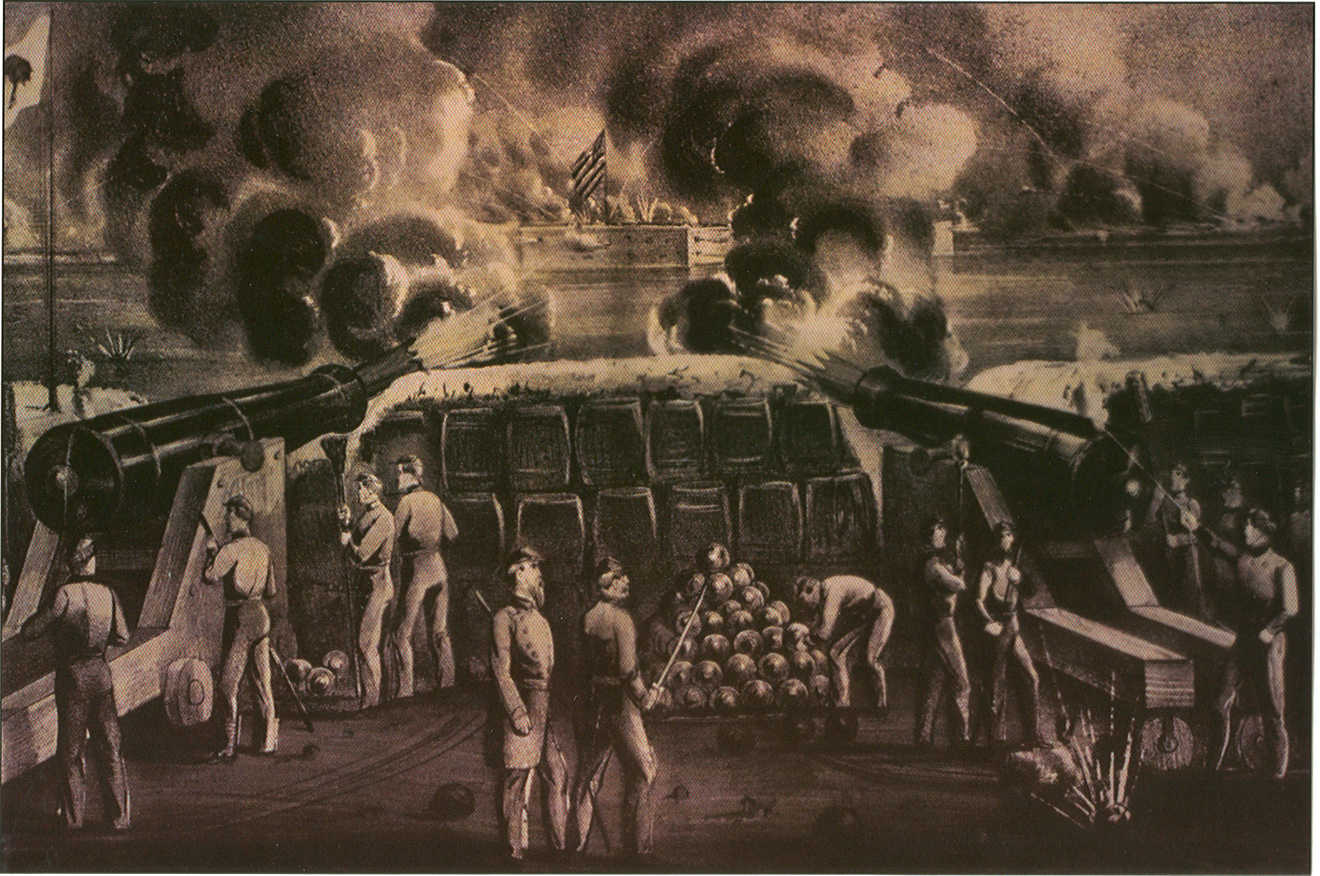
What really happened:
Lincoln would not allow slavery to expand any further.
2) South Carolina seceded from the Union followed by 10 other states.
3) Lincoln said he would keep the Union together at all costs.
4) Rebels opened fire on Ft. Sumter beginning the Civil War.

