Slide 1
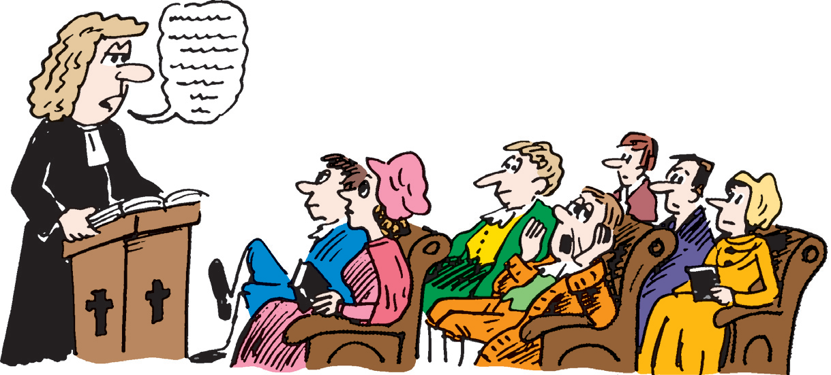
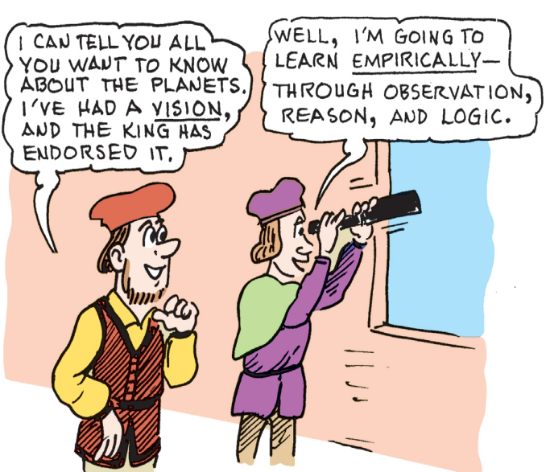
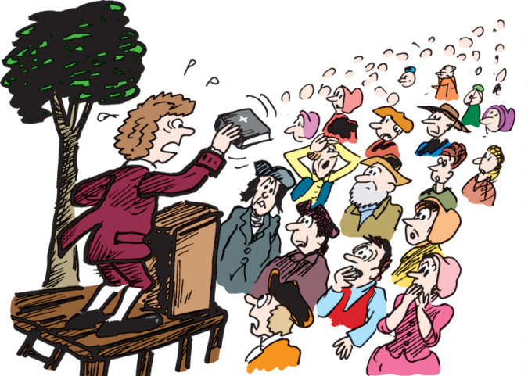
The Great Awakening and The Enlightenment
The Great Awakening
The Enlightenment
The Great Awakening is: a religious movement in the English colonies in the early 1700s
The Great Awakening was significant (important) because: encouraged people to look at God in a different way - very emotional, people took control of their worship and created new churches. This independent thinking contributed to the spread of democratic feelings.
People Involved: Jonathan Edwards
The Enlightenment is: Movement in Europe in the 1700s that encouraged the use of reason and experiment.
The Enlightenment was significant (important) because: Scientific advancement, explained many laws of nature, such as gravity.
People Involved: Ben Franklin, John Locke
FROM THIS: TO THIS:
Revelation Discovery
FROM THIS: TO THIS:

Slide 2
The Enlightenment
The Great Awakening
1730’s-1740’s
Pastors-George Whitefield and Jonathan Edwards
Religious Movement that appealed to the people’s heart
Man is evil=Only Christ can redeem
Encouraged equality among African Americans and won the right to challenge authority
1760’s
Leaders: Benjamin Franklin and John Locke
Science and Reason was the base of the movement
Wanted Natural Rights (life, liberty, and property)
Right to be free
Self Independence
Government
Rights
Rebels
Revolutionary Thinkers

