Slide 1
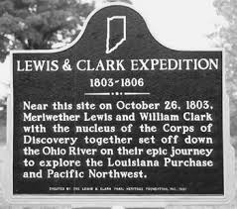
Historical Marker Instructions
After viewing the videos and taking notes you will create a historical marker for either Plymouth or Jamestown.
If your last name begins with A-L you are assigned Jamestown
M-Z- Plymouth.
A historical marker indicates the location of a historical event. It lists the name, dates, and description of the event. You will do the same for your colony. An example is below.
Make sure you include the following;
-Name
-Dates
-People/Settlers
-Description of colony and events that took place there

