Slide 1
INFLUENCES on Our Documents

Slide 2
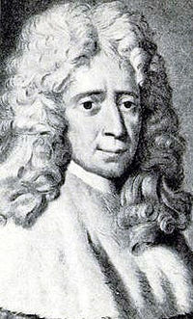
Influential People
Charles de Montesquieu (1689-1755)
French political philosopher during the Enlightenment
Believed that powers of government should be clearly defined and divided
Led to the idea of separation of powers among three branches

Slide 3
Influential People
John Locke (1632-1704)
English political philosopher and physician during the Enlightenment
Believed in human reason – for each of us to seek truth instead of just listening to authority figures
Led to the idea of self government

Slide 4
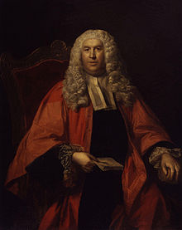
Influential People
William Blackstone (1723-1780)
English lawyer and accountant
Believed that human laws were as sure as scientific laws and just needed to be discovered (the existence of freewill and right to it existed just as the laws of gravity or motion)
His ideas helped shape the Declaration of Independence

Slide 5
Influential Documents
Mayflower compact (1620)
Signed by the Pilgrims upon arrival to America.
Based on the English constitution
First example of a document establishing self-government in America
Presented the idea of majority rule, which was a stepping stone to representative government

Slide 6
Influential Documents
Magna Carta (1215)
Established the idea that the power of the monarch was limited, not even the King was above the law.
This led one of the seven principles – Limited Government
Also guaranteed due process of law, which became the basis for the 5th amendment of the U.S. Constitution.

Slide 7
Influential Documents
English Bill of Rights (1689)
Established the power to make laws and collect taxes belonged to the elected representatives (Parliament)
Included a list (bill) of rights of the people.
Many of these rights are in the U.S. Bill of rights, including: freedom of speech, petition, right to bear arms, freedom from cruel and unusual punishment, and excessive bail.

Slide 8
Influential Documents
Declaration of Independence (1776)
Stated the colonies were a free and independent nation
Stated that people have rights and a government should respect and protect those rights

Slide 9
Influential Documents
Fundamental Orders of Connecticut (1639)
1st written constitution on American soil, written when the colony of Connecticut was founded
Allowed for voting on colonial issues and limited the power of the governor
Expanded the idea of representative government in the colonies.

Slide 10
Influential Documents
Articles of Confederation (1777)
First constitution of the United States of America
Formed a weak government due to people’s fears of a tyrannical rule.

