Slide 2
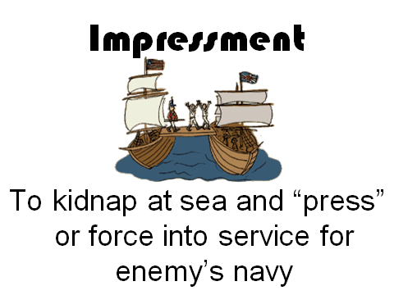

Slide 4
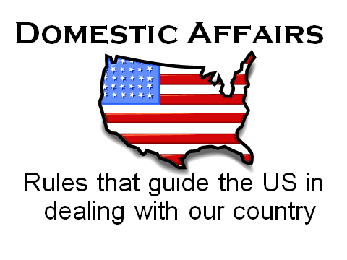

Slide 5
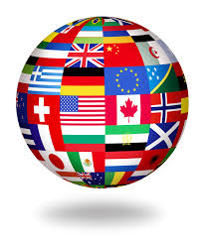
Foreign Affairs
Having to do with other countries

Slide 6
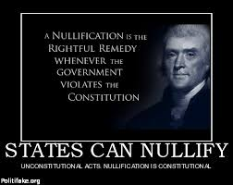
Nullify
To cancel a bad law

Slide 7
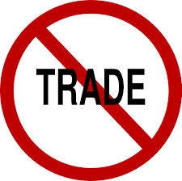
Embargo
A ban on Trade with other countries

Slide 8
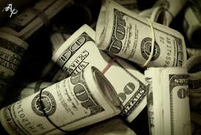
Laissez Faire
A type of economy in which the government has little involvement.

Slide 9
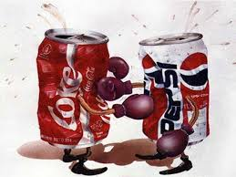
Free Market
A type of economy that encourages competition. Competition determines price.

Slide 10
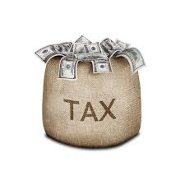
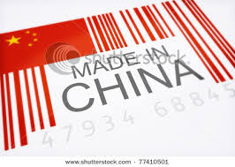
Protective Tariff
A tax on imported goods meant to force people to buy American made products.

