Slide 1
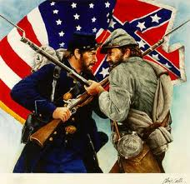
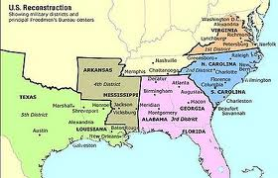
Reconstruction
The period (1865-1877) during which the states that had seceded to the Confederacy were controlled by the federal government before being readmitted to the Union.

Slide 2
Freedman Bureau
    The bureau supervised all relief and educational activities relating to refugees and freedman, including: issuing rations, clothing, and medicine
Established in the War Department
  Chief focus was to provide food, medical care, help with resettlement, administer justice, manage abandoned and confiscated property, regulate labor, and establish schools.
    The bureau also assumed custody of confiscated lands or property in the former Confederate States, border states, District of Columbia, and Indian Territory.

Slide 3
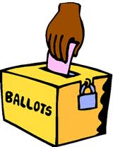
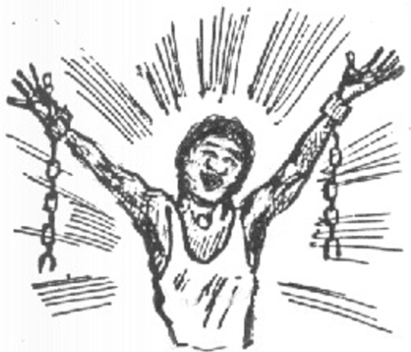
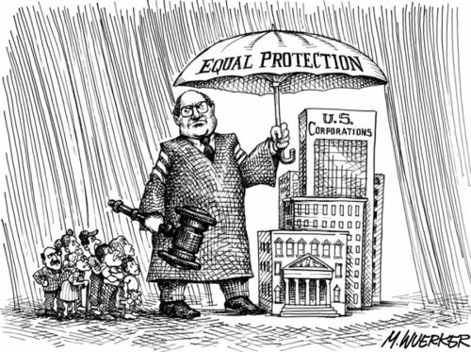
3 Amendment’s, and the end of slavery
13 Amendment: Abolished Slavery
  15th Amendment- Granted black men the right to vote
  14th Amendment- All persons born in the United States were citizens and all citizens were entitled to equal rights regardless of their race, and their rights were protected by due process of the law.

Slide 4
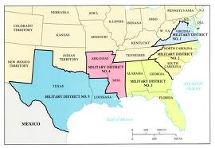
Reconstruction Acts
  Civil Rights Act of 1866- Granted citizenship to persons born in the U.S. except Native Americans.
  Reconstruction Act of 1867- Military occupation of the former confederate states, strict guidelines on representation and requirements for readmission to Union

Slide 5
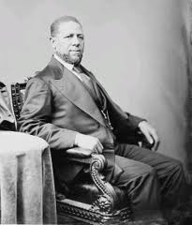
Hiram Rhodes Revels
Hiram Rhodes Revels was elected as the first African-American Senator
  Revel won notice for speaking out against racial segregation
  There were 22 African American men elected to the U.S. congress from the end of the Civil War to the turn of the 20th century.
  In 1870 the Mississippi state legislature chose Revels to fill a seat on the Senate that had been vacant since the start of the Civil War

Slide 6
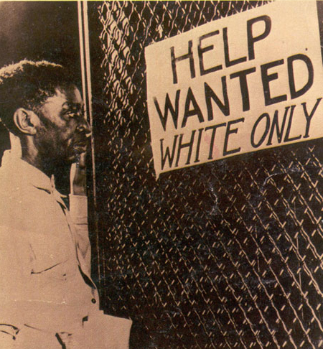
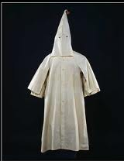

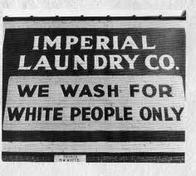
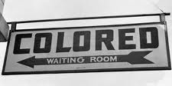
Laws for the South
The Ku Klux Klan was a secret society that gained support in 1868 and sought to destroy the Republican party in the South. The used harsh intimidation tactics on African Americans and other groups that helped African Americans.
  Black Codes- laws passed in the South during the Reconstruction to limit the opportunities for blacks
  Jim Crow Laws- laws passed to bypass laws created by the Radical Republicans, and any other Federal law that Southerners did not agree with concerning African Americans

Slide 7
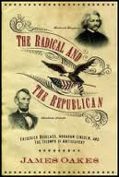
Radical Republicans
    Favored harsh treatment of the south and quick incorporation of the freeman into citizenship with full privileges including voting rights and the push for seizure of land from planters
    After Reconstruction was over Republicans didn’t have any political power in the South for over 100 years

Slide 8
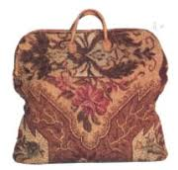
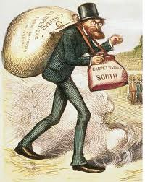

Carpet Baggers
    Got the name because: Carried luggage where they went
    They were not trusted by Southerners and took advantage of the their situation
    Northerners who went to the South and became involved in the new state politics

Slide 9
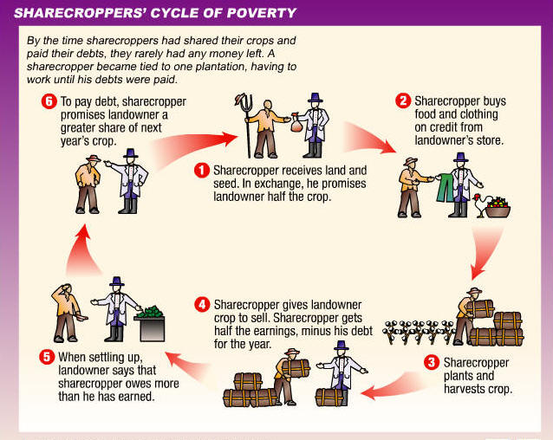
Freed Slaves
    Most organizations created to help freed slaves were underfunded and most freed slaves ended up working on plantations or sharecropping much like they had before
    Some were able to take advantage of the opportunities given to them by the government

Slide 10
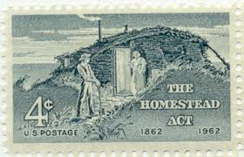
Homestead Act
    5. Of some 500 million acres dispersed by the General Land Office between 1862 -1904, only 8 million acres went to homesteaders
    1. Granted adult heads of families 160 acres of surveyed public land for a minimal filing fee
    3. After 5 years on the land, the original filer was entitled to the property, free and clear, except for a small registration fee.
    4. Most of the land went to speculators, cattlemen, miners, lumberman, and railroads.
    2. Claimants were required to “improve” the plot by building a dwelling and cultivate the land
    6. Impact- accelerated the settlement of the western settlement

Slide 11

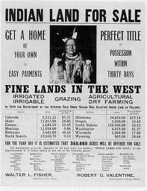
Dawes Act
    3. “To each head of a family, one-quarter of a section; and to each other single person under 18 years now living or who may be born prior to the date of the order of the President directing an allotment of the lands embracing any reservation, one 16th a section…”]
    1. The law allowed for the President to break up reservation land, which was held in common by the members of a tribe, into small allotments to be parceled out to individuals.
    2. Thus, Americans Indians registering on a tribal “roll” were granted allotments of reservation land.
    4. Impact- To protect Indian property rights

Slide 12





Morrill Act
    1. Act made it possible for new western states to establish colleges for their citizen
    2. New land grant institutions, which emphasized agriculture and mechanic arts, opened opportunities to thousands of farmers and working people previously excluded from higher education
    3. Act committed the Federal Government to grant each state 30,000 acres of public land for each of its Representatives and Senators in Congress
    5. Impact- Major universities such as: Nebraska, Washington State, Clemson, Cornell were chartered as land grant schools. Texas A&M was founded in 1871 for agriculture and mechanical college in Texas. State colleges brought higher education within the reach of millions of students, a development that couldn’t help but reshape the nation’s social and economic fabric.
    4. Established 16 higher education institutions specifically dedicated to the education of African Americans

Slide 13
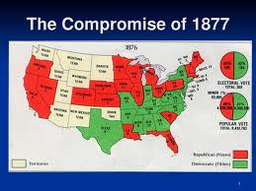
Compromise of 1877
    Included measures to appease the south by:
      Removal of all federal troops from the southern states
      Appointment of a least one Southern Democrat to Hayes’ Administration
      Construction of a second continental railroad in the south
      Legislation enacted to help industrialize the south
    Informal compromise between the Republican and Democrats in Congress that included measures to appease the south
    Happened after the Presidential election of 1876 when Congress formed the Electoral Commission

