Slide 1
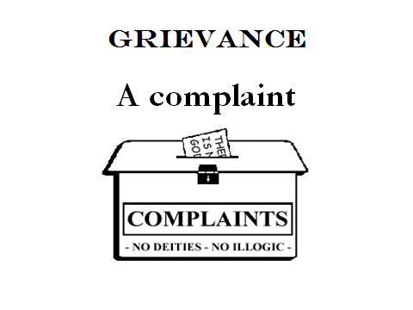

Slide 2
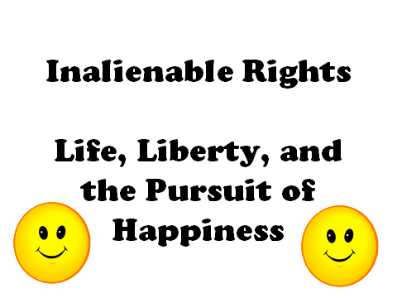

Slide 3
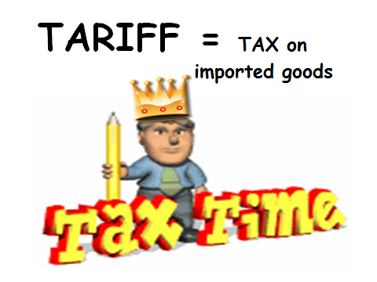

Slide 4
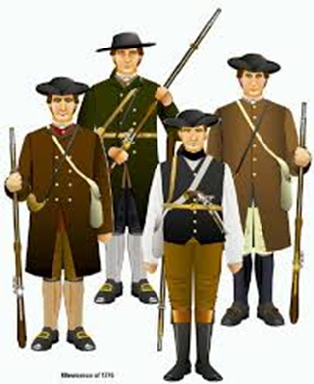
Minutemen
Colonial Volunteer who was prepared to fight at a moments notice

Slide 5
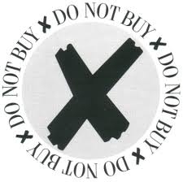
Boycott Refusal to buy certain goods and services as a protest.

Slide 6
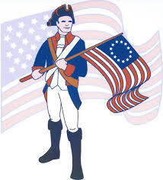
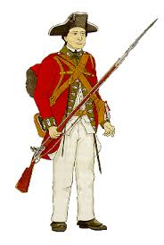
Patriot A rebel, a person who wanted independence from England Loyalist A person who was loyal to the King of England.
“Redcoat, lobsterback”

