Slide 1
Unit 3 Vocabulary
You will need a QR code reader for some of these words.

Slide 2
Complete ALL attached words. Due Friday 10/31

Slide 3
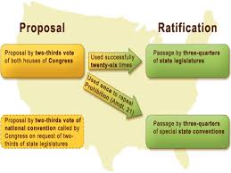
Amendment:
A change made to the constitution

Slide 11
Ratification
Sign or give formal consent to making it officially valid., To Approve

Slide 12
Grievance
A complaint, specifically complaints listed in the Declaration of Independence.

