Slide 1
Unit 5 Vocabulary

Slide 2
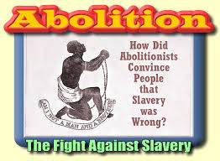
Abolition
An Anti- Slavery Movement in the mid 1800’s

Slide 3
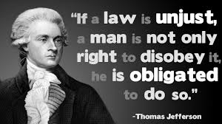
Civil Disobedience
Choosing to disobey the law in a peaceful manner.

Slide 5
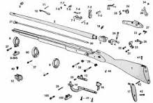
Interchangeable Parts
Parts that are identical so that they may be changed out of machines.

Slide 7
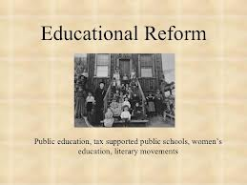
Reform
To make changes in order to improve Society, Politics, or the Economy

Slide 8
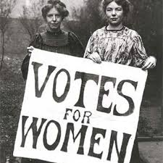
Suffrage
The movement for Women’s Right to vote.

Slide 9
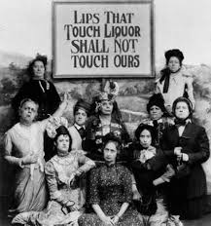
Temperance
The movement against the use and abuse of alcohol

Slide 11
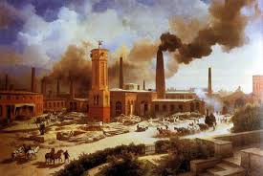
Urbanization
People moving and living in a city in order to work in factories. Growth of apartment living, leads to an increase in illness and death in the US because of close living quarters, trash, and unsanitary water.

Slide 12
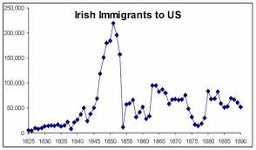
Immigration
Irish Immigrants come to US in the mid 1800’s due to the potato famine in Ireland.
Moving from one country to another in order to improve ones life.

