Slide 1
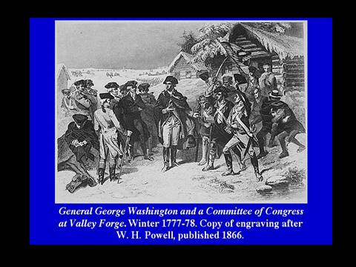
When looking at this document, look at the soldiers and how they are dressed vs the Committees of Congress.

